Slide 1
Getting Started
Hands-on B

Slide 2
Configure Git
Getting Started
Configure your Git username and email with git config
For Mac, use Terminal
For Windows, use PowerShell or Git Bash
$ git config --global user.name "GitHub_UserName"
$ git config --global user.email "example@email.com"
$ git config --global color.ui auto
$ git config --global --list
https://git-scm.com/book/en/v2/Getting-Started-First-Time-Git-Setup
Notes:
https://git-scm.com/book/en/v2/Customizing-Git-Git-Configuration
https://git-scm.com/book/en/v2/Getting-Started-First-Time-Git-Setup

Slide 3
Create a Local Git Repository
Getting Started
$ cd Documents
$ mkdir kintone_dojo
$ cd kintone_dojo
$ git init
Initialized empty Git repository in /Users/g001494/Documents/Kintone_Dojo/.git/
In your terminal, go to Documents and create a directory named kintone_dojo
$ pwd ~/Documents/kintone_dojo
In there, initialize a git repository
Repository is often shortened to Repo

Slide 4
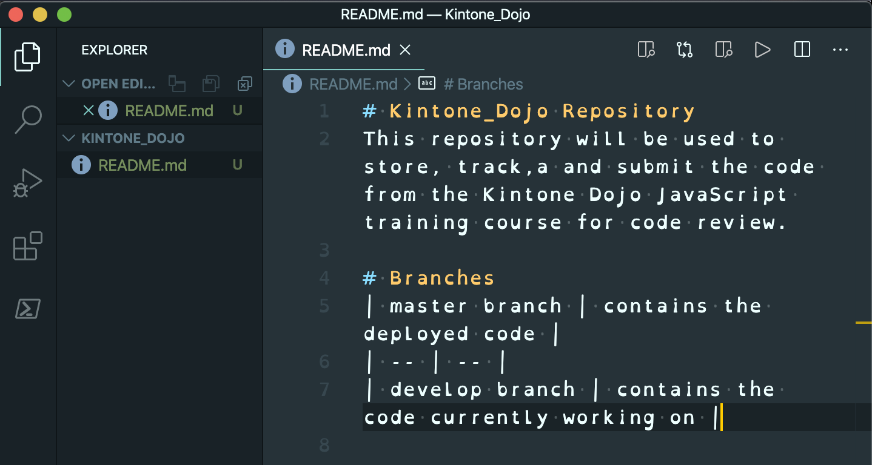
Add a README.md file to the Local Repo
Getting Started
$ touch README.md
$ code .
Create a README.md file
Open the current kintone_dojo directory with VS Code
See appendix for setup
Add a description of your repository in the markdown file

Slide 5
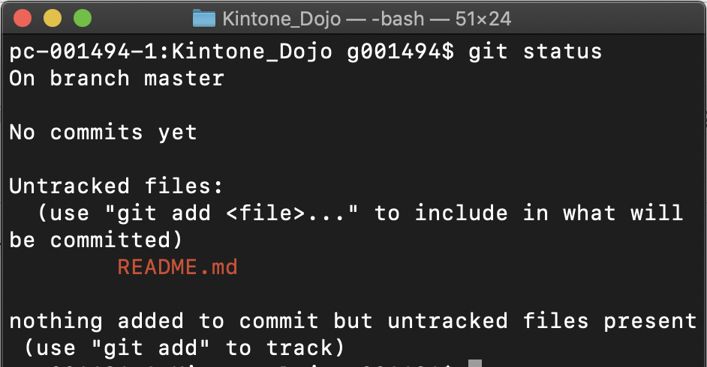
Check Git's Status
Getting Started
$ git status
git status
command that shows the working directory's & staging area's state
Changes to be committed: You can see which changes have & have not been staged
Untracked files: You can see which files are not being tracked by git
See that the README.md needs to be tracked by git
Notes:
https://git-scm.com/docs/git-status
https://www.atlassian.com/git/tutorials/inspecting-a-repository

Slide 6
Saving #1 - Add a File to Git's Staging Area
Getting Started
$ git add README.md
$ git status
On branch master
No commits yet
Changes to be committed:
(use "git rm --cached <file>…" to unstage)
new file: README.md
git add [file/folder]
command to add the [file/folder] to the staging area
Now the README.md is now in staging area
Notes:
https://git-scm.com/docs/git-add

Slide 7
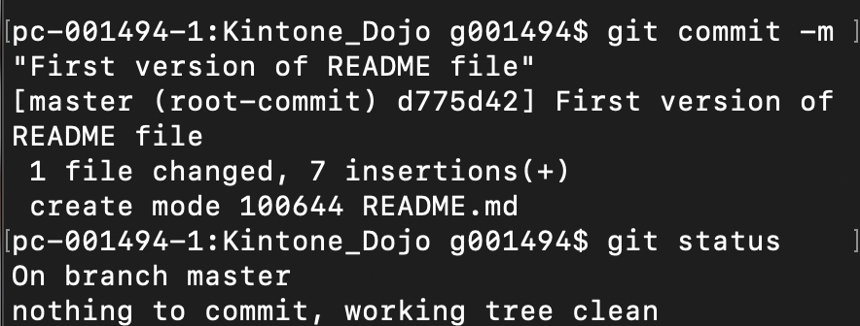
Saving #2 - Add a File to Git Repo
Getting Started
git commit -m "message"
command to add the file/folder to the repository
Now the README.md is now in the repository
specifically the master branch
$ git commit -m "First version of README file"
$ git status
Notes:
https://git-scm.com/docs/git-commit

Slide 8
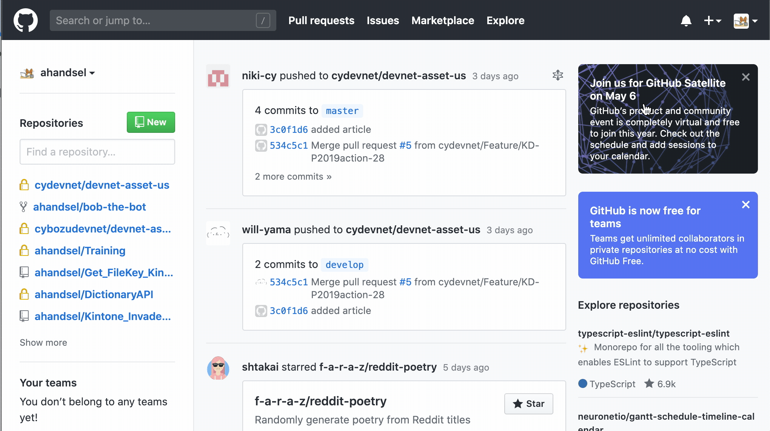
Create a GitHub Repository
Getting Started
Create a Repository
https://github.com/new
Name your repository kintone_dojo
Do not initialize repository with README

Slide 9
Local Git → GitHub
Getting Started
Push the existing repository!
Get the URL by clicking on Clone or download button & copying the HTTPS link
git remote add origin <link>
connects the git managed local repository with GitHub's remote
git remote
command to manage the remote repos
Notes:
https://help.github.com/en/github/using-git/adding-a-remote
https://git-scm.com/docs/git-remote
https://git-scm.com/docs/git-push

Slide 10
Local Git → GitHub
$ git remote add origin https://github.com/ahandsel/kintone_dojo.git
$ git push -u origin master
Username for 'github.com': ahandsel
Password for 'ahandsel@github.com': <Token_Here>
Counting objects: 100% (3/3), done.
Delta compression using up to 4 threads
Compressing objects: 100% (2/2), done.
Writing objects: 100% (3/3), 434 bytes | 86.00 KiB/s, done.
Total 3 (delta 0), reused 0 (delta 0), pack-reused 0
To https://github.com/ahandsel/kintone_dojo.git
* [new branch] master -> master
Branch 'master' set up to track remote branch 'master' from 'origin'.

Slide 11
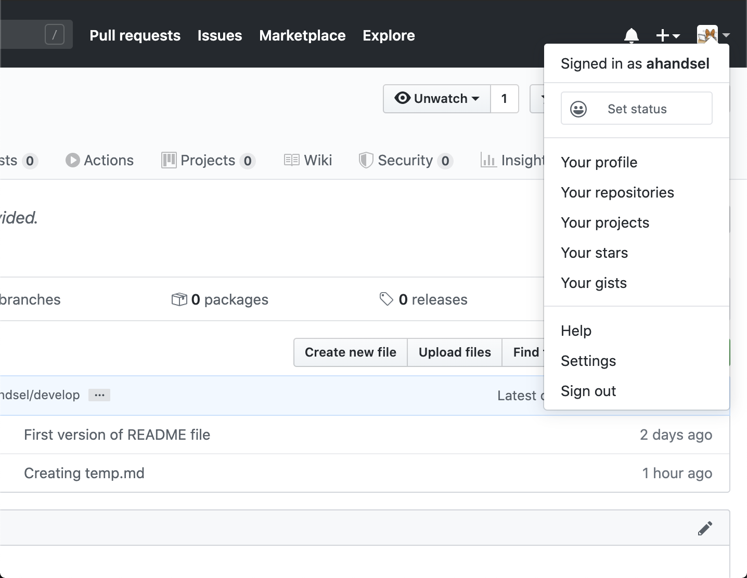


Congrats! Hands-on A & B is Completed!
Install & Configure git on PC
Create & Configure GitHub
Create & push a local repository
$ git config
--global
user.name
user.email
--list
$ git init
$ git status
$ git commit -m

Slide 12
Saving with Git and Remote Repos
Overview of Hands-on B

Slide 13
Saving Changes with Git
Saving with Git
There are 2 commands to transfer the items between the "locations"
working directory
There are 3 "locations" where files, folders, and changes are stored
git add
staging area
git commit
repository
https://git-scm.com/

Slide 14
Saving Changes with Git
Saving with Git
working directory
the current local directory that you are working on.
all changes first takes place here
git add
command that promotes a change from working directory to staging area
working directory
git add
staging area
git commit
repository
Notes:
https://git-scm.com/
https://dev.to/sublimegeek/git-staging-area-explained-like-im-five-1anh

Slide 15
Saving Changes with Git
Saving with Git
staging area
the buffer between the working directory & the repository
used to be called the 'index'
the promoted changes are bundled together, waiting for the next commit
working directory
git add
staging area
git commit
repository
Notes:
https://git-scm.com/
https://dev.to/sublimegeek/git-staging-area-explained-like-im-five-1anh

Slide 16
Saving Changes with Git
Saving with Git
git commit
command to record changes to the repository
used once all the files with the changes you want to be saved are in staging area
Game Check-In
it is like when you defeated the boss & want to save your progress in the game
comments per commit provides a natural documentation
working directory
git add
staging area
git commit
repository
Notes:
https://git-scm.com/
https://dev.to/sublimegeek/git-staging-area-explained-like-im-five-1anh

Slide 17
Saving Changes with Git
Saving with Git
repository
git repository is the actual ".git" folder inside a project
the folder tracks all the changes made in the project
i.e. the historian
remote repository (GitHub)
the repository on GitHub's server, allowing the code to be viewed by others
working directory
git add
staging area
git commit
repository
Notes:
https://git-scm.com/
https://dev.to/sublimegeek/git-staging-area-explained-like-im-five-1anh

Slide 18
Why have Staging Area?
Saving with Git
To stage a file = prepare the file for a commit
You can add and remove files that pertains to a specific commit you want to make.
Example Situation:
You are working on 2 features.
Feature A is done but feature B needs more work.
You need to commit your code before going home.
Solution: Add feature A related files to the staging area & commit.
Result: Feature A is committed and viewable to others while feature B is still in your working directory (un-staged).

Slide 19
Working with Remote Repos
Remote Repos
$ git remote -verbose
origin https://github.com/user/repo (fetch)
origin https://github.com /user/repo (push)
git remote command
manages the connection between your local & remote repositories
git remote --verbose
lists out the URLs that Git has stored & alias (nickname) that can be used when reading & writing to that remote repo
Notes:
https://git-scm.com/book/en/v2/Git-Basics-Working-with-Remotes
https://git-scm.com/docs/git-remote

Slide 20
Working with Remote Repos
Remote Repos
git remote add origin <link>
git creates an alias of the remote repository when you clone a remote repository to your local machine
i.e. nickname is assigned per remote repository's URL
Most common alias is called "origin."
Thus, both following commands does the same thing:
git push -u https://github.com/user/repo.git master
git remote add ALIAS https://github.com/ahandsel/repo.git
git push -u ALIAS master
Notes:
https://git-scm.com/book/en/v2/Git-Basics-Working-with-Remotes
https://git-scm.com/docs/git-remote

Slide 21
git push?
Remote Repos
git push [remote] [branch]
command to upload local repo content to a remote repo
i.e. export the commits from your local → remote repo
counterpart to git fetch (import commits to local repo)
Note: Pushing can potentially overwrite changes!
git push command works only for remote repo that has not been modified since your last push or clone
i.e. No one else changed the remote repo after you
if you & another user cloned at the same time and they push upstream before you, your push will rightly be rejected
you will need to fetch their work and include it in your push first
Notes:
https://git-scm.com/docs/git-push

Slide 22
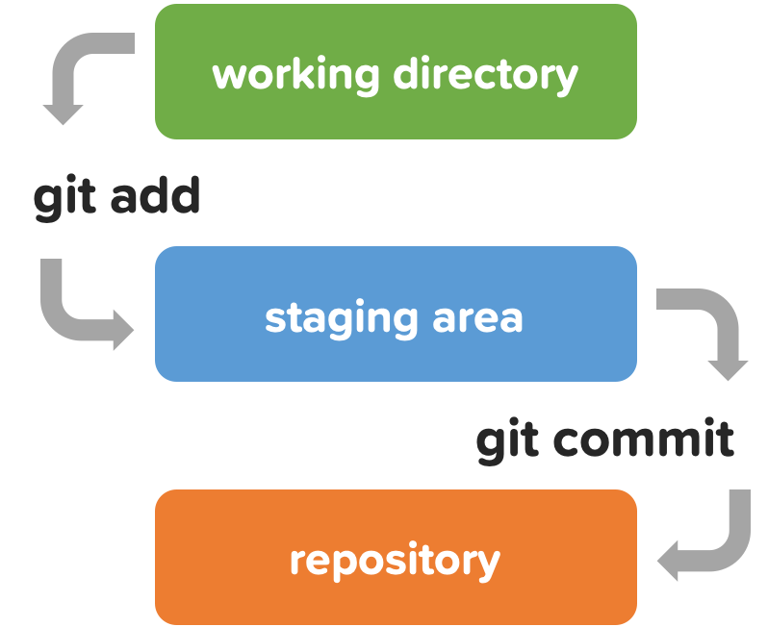
Hands-on B Review
Saving with Git
git remote
git push
Command to manage the connection between the local & remote repos
Command to upload local repo content to a remote repo

